Slide 1
Chapter 8-3
Recursion，Queue and
Character Strings
计算机系统概论
Introduction to Computing Systems
（CS1002A.03）
苗付友
mfy@ustc.edu.cn
2025 Fall
计算机科学与技术学院
School of Computer Science and Technology

Slide 2
Outline
1
1
Review
Recursion
2
2
From ENIAC to the Stored Program Computer
The Queue
3
3
A Machine Structure：von Neumann Model
Character Strings

Slide 3
1. Recursion
Recursion is a mechanism for expressing a function in terms of itself.
When used appropriately, the expressive power of recursion is going to save us a lot of headaches
Otherwise, it results in longer execution time and wasted energy

Slide 4
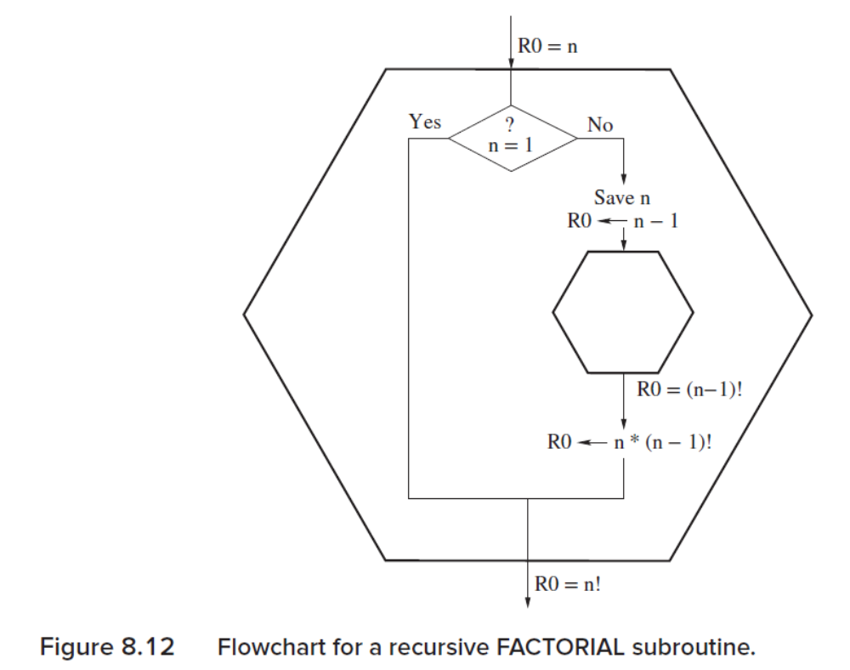
Bad Example: Factorial
To compute n!=n*(n-1)!

Slide 5
Bad Example: Factorial
FACT ST R1, Save1 ; Callee save R1
ADD R1,R0,#-1 ; Test if R0=1
BRz DONE ; If R0=1, R0 also contains (1)!, so we are done
ADD R1,R0,#0 ; Save n in R1, to be used after we compute (n-1)!
ADD R0,R1, #-1 ; Set R0 to n-1, and then call FACT
B JSR FACT ; On RET, R0 will contain (n-1)!
MUL R0,R0,R1 ; Multiply n times (n-1)!, yielding n! in R0
DONE LD R1, Save1 ; Callee restore R1
RET
Save1 .BLKW 1

Slide 6
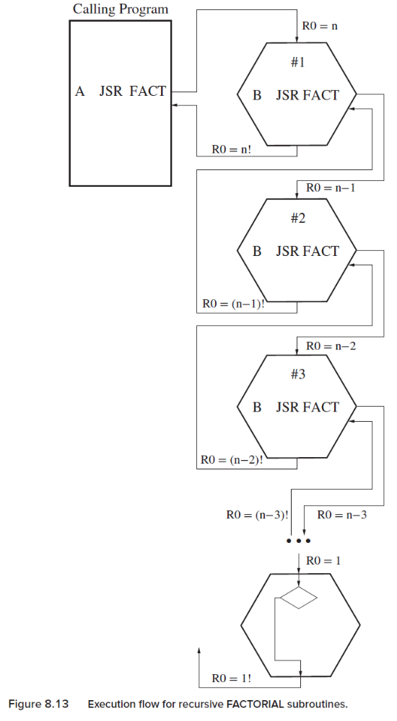
Bad Example: Factorial
In Calling Program: A JSR FACT: A+1 →R7
In #1: B JSR FACT: B+1→ R7
R7=A+1 is wiped out by B+1,, can not return.

Slide 7
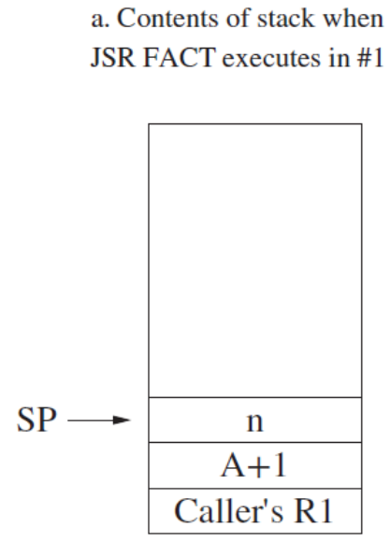
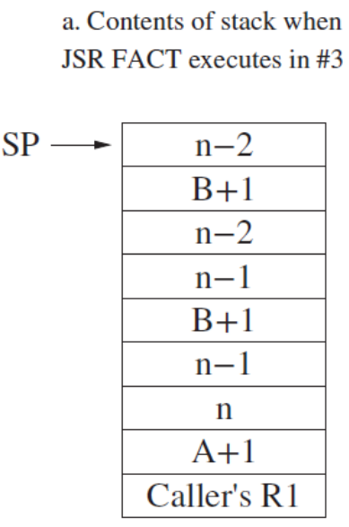
Recursive subroutine FACT
FACT ADD R6,R6,#-1
STR R1,R6,#0 ; Push Caller’s R1 on the stack, so we can use R1.
;
ADD R1,R0,#-1 ; If n=1, we are done since 1! = 1
BRz NO_RECURSE
;
ADD R6,R6,#-1
STR R7,R6,#0 ; Push return linkage onto stack
ADD R6,R6,#-1
STR R0,R6,#0 ; Push n on the stack
;
ADD R0,R0,#-1 ; Form n-1, argument of JSR
B JSR FACT
LDR R1,R6,#0 ; Pop n from the stack
ADD R6,R6,#1
MUL R0,R0,R1 ; form n*(n-1)!
;
LDR R7,R6,#0 ; Pop return linkage into R7
ADD R6,R6,#1
NO_RECURSE LDR R1,R6,#0 ; Pop caller’s R1 back into R1
ADD R6,R6,#1
RET

Slide 8
Recursive subroutine FACT
FACT ADD R6,R6,#-1
STR R1,R6,#0 ; Push Caller’s R1 on the stack, so we can use R1.
;
ADD R1,R0,#-1 ; If n=1, we are done since 1! = 1
BRz NO_RECURSE
;
ADD R6,R6,#-1
STR R7,R6,#0 ; Push return linkage onto stack
ADD R6,R6,#-1
STR R0,R6,#0 ; Push n on the stack
;
ADD R0,R0,#-1 ; Form n-1, argument of JSR
B JSR FACT
LDR R1,R6,#0 ; Pop n from the stack
ADD R6,R6,#1
MUL R0,R0,R1 ; form n*(n-1)!
;
LDR R7,R6,#0 ; Pop return linkage into R7
ADD R6,R6,#1
NO_RECURSE LDR R1,R6,#0 ; Pop caller’s R1 back into R1
ADD R6,R6,#1
RET
Example: R0=n=3
Top →
Caller’s R1
R0=3, R1=2

Slide 9
Recursive subroutine FACT
FACT ADD R6,R6,#-1
STR R1,R6,#0 ; Push Caller’s R1 on the stack, so we can use R1.
;
ADD R1,R0,#-1 ; If n=1, we are done since 1! = 1
BRz NO_RECURSE
;
ADD R6,R6,#-1
STR R7,R6,#0 ; Push return linkage onto stack
ADD R6,R6,#-1
STR R0,R6,#0 ; Push n on the stack
;
ADD R0,R0,#-1 ; Form n-1, argument of JSR
B JSR FACT
LDR R1,R6,#0 ; Pop n from the stack
ADD R6,R6,#1
MUL R0,R0,R1 ; form n*(n-1)!
;
LDR R7,R6,#0 ; Pop return linkage into R7
ADD R6,R6,#1
NO_RECURSE LDR R1,R6,#0 ; Pop caller’s R1 back into R1
ADD R6,R6,#1
RET
Example: R0=n=3
Top →
R0=3
R0=2
A+1
Caller’s R1
R1=2 R0=3

Slide 10
Recursive subroutine FACT
FACT ADD R6,R6,#-1
STR R1,R6,#0 ; Push Caller’s R1 on the stack, so we can use R1.
;
ADD R1,R0,#-1 ; If n=1, we are done since 1! = 1
BRz NO_RECURSE
;
ADD R6,R6,#-1
STR R7,R6,#0 ; Push return linkage onto stack
ADD R6,R6,#-1
STR R0,R6,#0 ; Push n on the stack
;
ADD R0,R0,#-1 ; Form n-1, argument of JSR
B JSR FACT ;B+1→R7
LDR R1,R6,#0 ; Pop n from the stack
ADD R6,R6,#1
MUL R0,R0,R1 ; form n*(n-1)!
;
LDR R7,R6,#0 ; Pop return linkage into R7
ADD R6,R6,#1
NO_RECURSE LDR R1,R6,#0 ; Pop caller’s R1 back into R1
ADD R6,R6,#1
RET
Example: R0=n=3
Top →
R1=2
n=3
R0=2
A+1
Caller’s R1
R1=2

Slide 11
Recursive subroutine FACT
FACT ADD R6,R6,#-1
STR R1,R6,#0 ; Push Caller’s R1 on the stack, so we can use R1.
;
ADD R1,R0,#-1 ; If n=1, we are done since 1! = 1
BRz NO_RECURSE
;
ADD R6,R6,#-1
STR R7,R6,#0 ; Push return linkage onto stack
ADD R6,R6,#-1
STR R0,R6,#0 ; Push n on the stack
;
ADD R0,R0,#-1 ; Form n-1, argument of JSR
B JSR FACT
LDR R1,R6,#0 ; Pop n from the stack
ADD R6,R6,#1
MUL R0,R0,R1 ; form n*(n-1)!
;
LDR R7,R6,#0 ; Pop return linkage into R7
ADD R6,R6,#1
NO_RECURSE LDR R1,R6,#0 ; Pop caller’s R1 back into R1
ADD R6,R6,#1
RET
Example: R0=n=3
Top →
R1=R0-1=1
B+1
R1=2
n=3
R0=2
A+1
Caller’s R1

Slide 12
Recursive subroutine FACT
FACT ADD R6,R6,#-1
STR R1,R6,#0 ; Push Caller’s R1 on the stack, so we can use R1.
;
ADD R1,R0,#-1 ; If n=1, we are done since 1! = 1
BRz NO_RECURSE
;
ADD R6,R6,#-1
STR R7,R6,#0 ; Push return linkage onto stack
ADD R6,R6,#-1
STR R0,R6,#0 ; Push n on the stack
;
ADD R0,R0,#-1 ; Form n-1, argument of JSR
B JSR FACT
LDR R1,R6,#0 ; Pop n from the stack
ADD R6,R6,#1
MUL R0,R0,R1 ; form n*(n-1)!
;
LDR R7,R6,#0 ; Pop return linkage into R7
ADD R6,R6,#1
NO_RECURSE LDR R1,R6,#0 ; Pop caller’s R1 back into R1
ADD R6,R6,#1
RET
Example: R0=n=3
Top →
R0=1
R0=2
B+1
R1=R0-1=1
R1=2
n=3
A+1
Caller’s R1

Slide 13
Recursive subroutine FACT
FACT ADD R6,R6,#-1
STR R1,R6,#0 ; Push Caller’s R1 on the stack, so we can use R1.
;
ADD R1,R0,#-1 ; If n=1, we are done since 1! = 1
BRz NO_RECURSE
;
ADD R6,R6,#-1
STR R7,R6,#0 ; Push return linkage onto stack
ADD R6,R6,#-1
STR R0,R6,#0 ; Push n on the stack
;
ADD R0,R0,#-1 ; Form n-1, argument of JSR
B JSR FACT
LDR R1,R6,#0 ; Pop n from the stack
ADD R6,R6,#1
MUL R0,R0,R1 ; form n*(n-1)!
;
LDR R7,R6,#0 ; Pop return linkage into R7
ADD R6,R6,#1
NO_RECURSE LDR R1,R6,#0 ; Pop caller’s R1 back into R1
ADD R6,R6,#1
RET
Example: R0=n=3
R1=R0-1=0
Top →
R1=1
R0=2
R0=1
B+1
R1=2
n=3
A+1
Caller’s R1

Slide 14
Recursive subroutine FACT
FACT ADD R6,R6,#-1
STR R1,R6,#0 ; Push Caller’s R1 on the stack, so we can use R1.
;
ADD R1,R0,#-1 ; If n=1, we are done since 1! = 1
BRz NO_RECURSE
;
ADD R6,R6,#-1
STR R7,R6,#0 ; Push return linkage onto stack
ADD R6,R6,#-1
STR R0,R6,#0 ; Push n on the stack
;
ADD R0,R0,#-1 ; Form n-1, argument of JSR
B JSR FACT
LDR R1,R6,#0 ; Pop n from the stack
ADD R6,R6,#1
MUL R0,R0,R1 ; form n*(n-1)!
;
LDR R7,R6,#0 ; Pop return linkage into R7
ADD R6,R6,#1
NO_RECURSE LDR R1,R6,#0 ; Pop caller’s R1 back into R1
ADD R6,R6,#1
RET
Example: R0=n=3
R1=1
R1=1
R0=2
R0=1
Top →
B+1
R1=2
n=3
A+1
Caller’s R1

Slide 15
Recursive subroutine FACT
FACT ADD R6,R6,#-1
STR R1,R6,#0 ; Push Caller’s R1 on the stack, so we can use R1.
;
ADD R1,R0,#-1 ; If n=1, we are done since 1! = 1
BRz NO_RECURSE
;
ADD R6,R6,#-1
STR R7,R6,#0 ; Push return linkage onto stack
ADD R6,R6,#-1
STR R0,R6,#0 ; Push n on the stack
;
ADD R0,R0,#-1 ; Form n-1, argument of JSR
B JSR FACT
LDR R1,R6,#0 ; Pop n from the stack
ADD R6,R6,#1
MUL R0,R0,R1 ; form n*(n-1)!
;
LDR R7,R6,#0 ; Pop return linkage into R7
ADD R6,R6,#1
NO_RECURSE LDR R1,R6,#0 ; Pop caller’s R1 back into R1
ADD R6,R6,#1
RET
Example: R0=n=3
R1=1
R0=2
R0=1 , R1=2
Top →
B+1
R1=2
n=3
A+1
Caller’s R1

Slide 16
Recursive subroutine FACT
FACT ADD R6,R6,#-1
STR R1,R6,#0 ; Push Caller’s R1 on the stack, so we can use R1.
;
ADD R1,R0,#-1 ; If n=1, we are done since 1! = 1
BRz NO_RECURSE
;
ADD R6,R6,#-1
STR R7,R6,#0 ; Push return linkage onto stack
ADD R6,R6,#-1
STR R0,R6,#0 ; Push n on the stack
;
ADD R0,R0,#-1 ; Form n-1, argument of JSR
B JSR FACT
LDR R1,R6,#0 ; Pop n from the stack
ADD R6,R6,#1
MUL R0,R0,R1 ; form n*(n-1)!
;
LDR R7,R6,#0 ; Pop return linkage into R7
ADD R6,R6,#1
NO_RECURSE LDR R1,R6,#0 ; Pop caller’s R1 back into R1
ADD R6,R6,#1
RET
Example: R0=n=3
R1=1
R0=2
R1=2
Top →
B+1
R0=R0*R1=1*2=2
R1=2
n=3
A+1
Caller’s R1

Slide 17
Recursive subroutine FACT
FACT ADD R6,R6,#-1
STR R1,R6,#0 ; Push Caller’s R1 on the stack, so we can use R1.
;
ADD R1,R0,#-1 ; If n=1, we are done since 1! = 1
BRz NO_RECURSE
;
ADD R6,R6,#-1
STR R7,R6,#0 ; Push return linkage onto stack
ADD R6,R6,#-1
STR R0,R6,#0 ; Push n on the stack
;
ADD R0,R0,#-1 ; Form n-1, argument of JSR
B JSR FACT
LDR R1,R6,#0 ; Pop n from the stack
ADD R6,R6,#1
MUL R0,R0,R1 ; form n*(n-1)!
;
LDR R7,R6,#0 ; Pop return linkage into R7
ADD R6,R6,#1
NO_RECURSE LDR R1,R6,#0 ; Pop caller’s R1 back into R1
ADD R6,R6,#1
RET
Example: R0=n=3
R1=1
R0=2
R1=2
B+1
R0=R0*R1=1*2=2
Top →
R1=2
n=3
A+1
Caller’s R1

Slide 18
Recursive subroutine FACT
FACT ADD R6,R6,#-1
STR R1,R6,#0 ; Push Caller’s R1 on the stack, so we can use R1.
;
ADD R1,R0,#-1 ; If n=1, we are done since 1! = 1
BRz NO_RECURSE
;
ADD R6,R6,#-1
STR R7,R6,#0 ; Push return linkage onto stack
ADD R6,R6,#-1
STR R0,R6,#0 ; Push n on the stack
;
ADD R0,R0,#-1 ; Form n-1, argument of JSR
B JSR FACT
LDR R1,R6,#0 ; Pop n from the stack
ADD R6,R6,#1
MUL R0,R0,R1 ; form n*(n-1)!
;
LDR R7,R6,#0 ; Pop return linkage into R7
ADD R6,R6,#1
NO_RECURSE LDR R1,R6,#0 ; Pop caller’s R1 back into R1
ADD R6,R6,#1
RET
Example: R0=n=3
R1=1
R0=2
B+1
R0=R0*R1=1*2=2
R1=2
R1=2
Top →
n=3
A+1
Caller’s R1

Slide 19
Recursive subroutine FACT
FACT ADD R6,R6,#-1
STR R1,R6,#0 ; Push Caller’s R1 on the stack, so we can use R1.
;
ADD R1,R0,#-1 ; If n=1, we are done since 1! = 1
BRz NO_RECURSE
;
ADD R6,R6,#-1
STR R7,R6,#0 ; Push return linkage onto stack
ADD R6,R6,#-1
STR R0,R6,#0 ; Push n on the stack
;
ADD R0,R0,#-1 ; Form n-1, argument of JSR
B JSR FACT
LDR R1,R6,#0 ; Pop n from the stack
ADD R6,R6,#1
MUL R0,R0,R1 ; form n*(n-1)!
;
LDR R7,R6,#0 ; Pop return linkage into R7
ADD R6,R6,#1
NO_RECURSE LDR R1,R6,#0 ; Pop caller’s R1 back into R1
ADD R6,R6,#1
RET
Example: R0=n=3
R1=1
R0=2
B+1
R0=R0*R1=1*2=2
R1=2
n=3
R1=3
Top →
A+1
Caller’s R1

Slide 20
Recursive subroutine FACT
FACT ADD R6,R6,#-1
STR R1,R6,#0 ; Push Caller’s R1 on the stack, so we can use R1.
;
ADD R1,R0,#-1 ; If n=1, we are done since 1! = 1
BRz NO_RECURSE
;
ADD R6,R6,#-1
STR R7,R6,#0 ; Push return linkage onto stack
ADD R6,R6,#-1
STR R0,R6,#0 ; Push n on the stack
;
ADD R0,R0,#-1 ; Form n-1, argument of JSR
B JSR FACT
LDR R1,R6,#0 ; Pop n from the stack
ADD R6,R6,#1
MUL R0,R0,R1 ; form n*(n-1)!
;
LDR R7,R6,#0 ; Pop return linkage into R7
ADD R6,R6,#1
NO_RECURSE LDR R1,R6,#0 ; Pop caller’s R1 back into R1
ADD R6,R6,#1
RET
Example: R0=n=3
R1=1
R0=2
B+1
R0=R0*R1=1*2=2
R1=2
n=3
R1=3
R0=R0*R1=2*3=6
Top →
A+1
Caller’s R1

Slide 21
Recursive subroutine FACT
FACT ADD R6,R6,#-1
STR R1,R6,#0 ; Push Caller’s R1 on the stack, so we can use R1.
;
ADD R1,R0,#-1 ; If n=1, we are done since 1! = 1
BRz NO_RECURSE
;
ADD R6,R6,#-1
STR R7,R6,#0 ; Push return linkage onto stack
ADD R6,R6,#-1
STR R0,R6,#0 ; Push n on the stack
;
ADD R0,R0,#-1 ; Form n-1, argument of JSR
B JSR FACT
LDR R1,R6,#0 ; Pop n from the stack
ADD R6,R6,#1
MUL R0,R0,R1 ; form n*(n-1)!
;
LDR R7,R6,#0 ; Pop return linkage into R7
ADD R6,R6,#1
NO_RECURSE LDR R1,R6,#0 ; Pop caller’s R1 back into R1
ADD R6,R6,#1
RET
Example: R0=n=3
R1=1
R0=2
B+1
R0=R0*R1=1*2=2
R1=2
n=3
R1=3
R0=R0*R1=2*3=6
A+1
Top →
Caller’s R1

Slide 22
Recursive subroutine FACT
FACT ADD R6,R6,#-1
STR R1,R6,#0 ; Push Caller’s R1 on the stack, so we can use R1.
;
ADD R1,R0,#-1 ; If n=1, we are done since 1! = 1
BRz NO_RECURSE
;
ADD R6,R6,#-1
STR R7,R6,#0 ; Push return linkage onto stack
ADD R6,R6,#-1
STR R0,R6,#0 ; Push n on the stack
;
ADD R0,R0,#-1 ; Form n-1, argument of JSR
B JSR FACT
LDR R1,R6,#0 ; Pop n from the stack
ADD R6,R6,#1
MUL R0,R0,R1 ; form n*(n-1)!
;
LDR R7,R6,#0 ; Pop return linkage into R7
ADD R6,R6,#1
NO_RECURSE LDR R1,R6,#0 ; Pop caller’s R1 back into R1
ADD R6,R6,#1
RET
Example: R0=n=3
R1=1
R0=2
B+1
R1=2
n=3
R1=3
R0=R0*R1=2*3=6
A+1
Caller’s R1
R1=old value
Top →

Slide 23
Recursive subroutine FACT
FACT ADD R6,R6,#-1
STR R1,R6,#0 ; Push Caller’s R1 on the stack, so we can use R1.
;
ADD R1,R0,#-1 ; If n=1, we are done since 1! = 1
BRz NO_RECURSE
;
ADD R6,R6,#-1
STR R7,R6,#0 ; Push return linkage onto stack
ADD R6,R6,#-1
STR R0,R6,#0 ; Push n on the stack
;
ADD R0,R0,#-1 ; Form n-1, argument of JSR
B JSR FACT
LDR R1,R6,#0 ; Pop n from the stack
ADD R6,R6,#1
MUL R0,R0,R1 ; form n*(n-1)!
;
LDR R7,R6,#0 ; Pop return linkage into R7
ADD R6,R6,#1
NO_RECURSE LDR R1,R6,#0 ; Pop caller’s R1 back into R1
ADD R6,R6,#1
RET
Example: R0=n=3
R1=1
R0=2
B+1
R1=2
n=3
R0=R0*R1=2*3=6
A+1
Caller’s R1
R1=old value
Top →
Return to calling program

Slide 24
Implementing FACT iteratively (without recursion)
FACT ST R1,SAVE_R1
ADD R1,R0,#0 ; R1=R0=n
ADD R0,R0, #-1 ; R0=n-1
BRz DONE
AGAIN MUL R1,R1,R0 ; (n*(n-1))*(n-2)...
ADD R0,R0,#-1 ; R0 gets next integer for MUL
BRnp AGAIN
DONE ADD R0,R1,#0 ; Move n! to R0
LD R1,SAVE_R1
RET
SAVE_R1 .BLKW 1

Slide 25
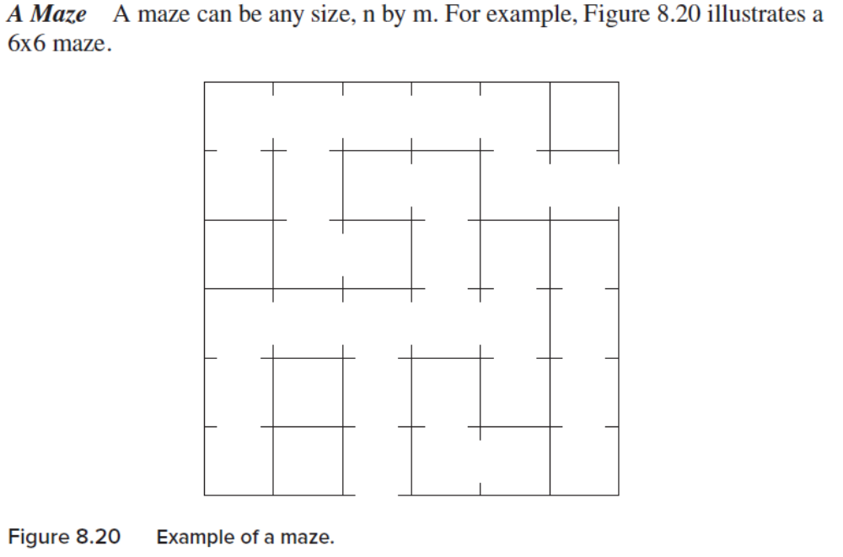
The Maze: a Good Example
Given a maze and a starting position within the maze, write a program that determines whether or not there is a way out of the maze from your starting position.
Specification of each cell in the maze
  Bit[4]=1 if there is a door to the outside world; Bit[4]=0 if no door.
  Bit[3]=1 if there is a door to the cell to the north; Bit[3]=0 if no door.
  Bit[2]=1 if there is a door to the cell to the east; Bit[2]=0 if no door.
  Bit[1]=1 if there is a door to the cell to the south; Bit[1]=0 if no door.
  Bit[0]=1 if there is a door to the cell to the west; Bit[0]=0 if no door.

Slide 26
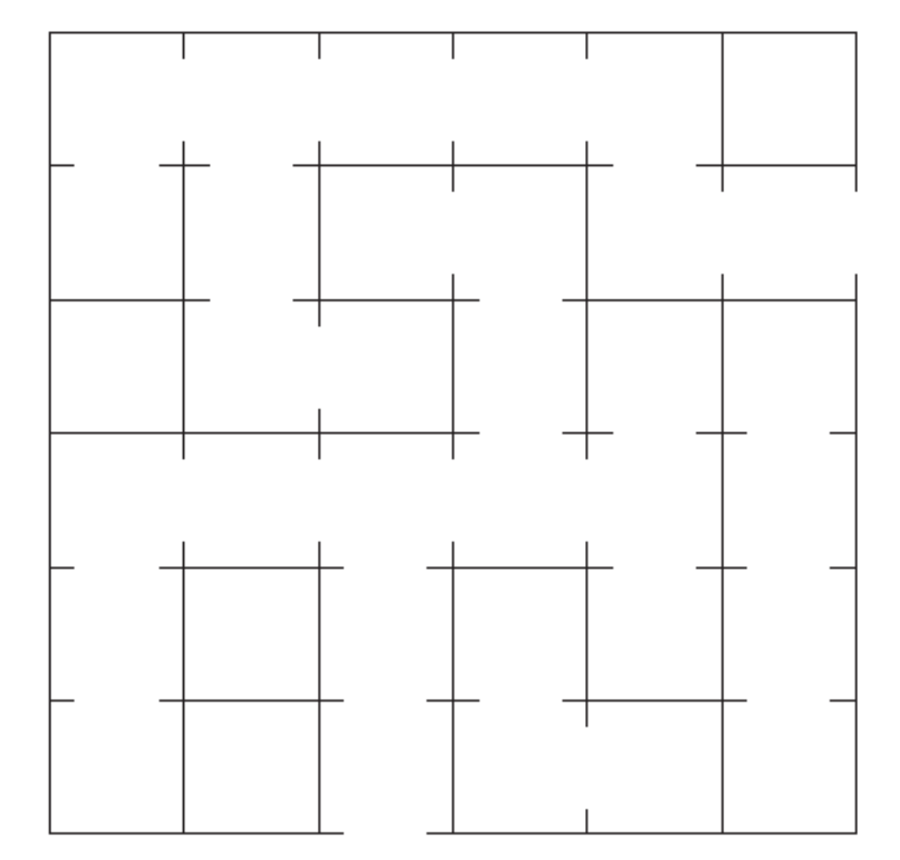
00 .ORIG x5000
01 MAZE .FILL x0006 ; first row: indices 0 to 5
02 .FILL x0007
03 .FILL x0005
04 .FILL x0005
05 .FILL x0003
06 .FILL x0000
07 ; second row: indices 6 to 11
08 .FILL x0008
09 .FILL x000A
0A .FILL x0004
0B .FILL x0003
0C .FILL x000C
0D .FILL x0015
0E ; third row: indices 12 to 17
0F .FILL x0000
10 .FILL x000C
11 .FILL x0001
12 .FILL x000A
13 .FILL x0002
14 .FILL x0002
…….
2A .END
Figure 8.22 Specification of the maze of Figure 8.20.
x5000
x5001
x5002
x5003
x5004
x5005
MAZE

Slide 27
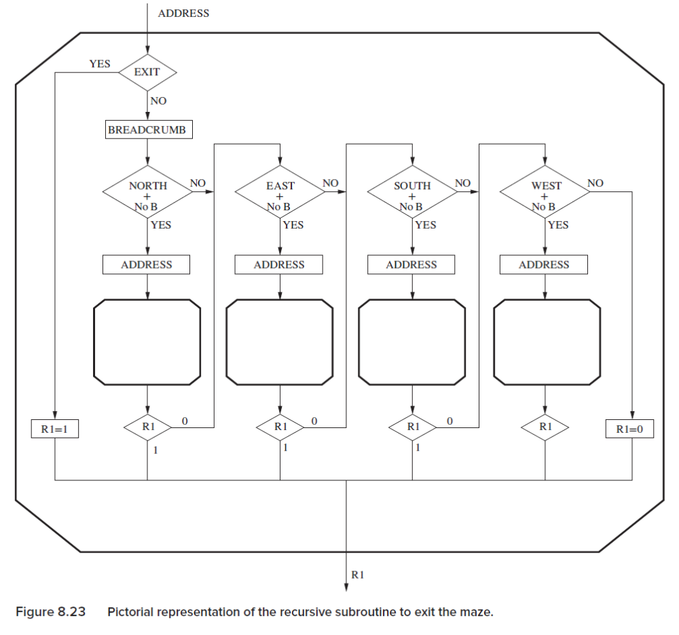
Recursive Subroutine to exit the Maze

Slide 28
Description of the Algorithm
a. From our cell, we ask if we can exit. If yes, we are done. We exit with R1=1.
b. If not, we put a breadcrumb in our cell. Our breadcrumb is bit [15] of the
word corresponding to our current cell. We set it to 1.
c. We ask two questions: Is there a door to the north, and have we never
visited the cell to the north before? If the answer to both is yes, we set the
address to the cell to the north, and JSR FIND EXIT. We set the address to
the cell to the north by simply subtracting 6 from the address of the current cell. Why 6?
Because the cells are stored in row major order, and the number of columns in the maze is 6.
d. If the answer to either question is no, or if going north resulted in failure,
we ask: Is there a door to the east, and have we never visited that cell
before? If the answer to both is yes, we set the address to the address of the
cell to the east (by adding 1 to the address) and JSR FIND EXIT.
e. If going east does not get us out, we repeat the question for south, and if
that does not work, then for west.
f. If we end up with no door to the west to a cell we have not visited, or if there
is a door and we haven’t visited, but it results in failure, we are done. We
cannot exit the maze from our starting position. We set R1=0 and return.

Slide 29
; Recursive subroutine that determines if there is
; a path from current cell to the outside world.
; input: R0, current cell address
; output: R1, YES (1) or NO (0)
.ORIG x4000
01 FIND_EXIT ; save modified registers into the stack.
02 ADD R6, R6, #-1
03 STR R2, R6, #0 ; R2 holds the cell data of the caller
04 ADD R6, R6, #-1
05 STR R3, R6, #0 ; R3 holds the cell address of the caller
06 ADD R6, R6, #-1
07 STR R7, R6, #0 ; R7 holds the PC of the caller
08
09 ; Move cell address to R3, since we need to use R0
0A ; as the input to recursive subroutine calls.
0B ADD R3, R0, #0
0C
0D ; If the exit is in this cell, return YES
0E LDR R2, R0, #0 ; R2 now holds the current cell data
0F LD R7, EXIT_MASK
10 AND R7, R2, R7
11 BRnp DONE_YES
12
13 ; Put breadcrumb in the current cell.
14 LD R7, BREADCRUMB
15 ADD R2, R2, R7
16 STR R2, R0, #0
17
18 ; check the north cell for a path to exit
19 CHECK_NORTH LD R7, NORTH_MASK
1A AND R7, R2, R7
1B BRz CHECK_EAST ; If north is blocked, check east
1C LDR R7, R3, #-6
1D BRn CHECK_EAST ; If a breadcrumb in the north
;cell, check east. bit[15]=1, negative
1E ADD R0, R3, #-6
1F JSR FIND_EXIT ; Recursively check the north cell
20 ADD R1, R1, #0
BRp DONE_YES ; If a path from north cell found,
;return YES
23 ; check the north cell for a path to exit
24 CHECK_EAST LD R7, EAST_MASK
AND R7, R2, R7
BRz CHECK_SOUTH; If the way to east is
; blocked, check south
27 LDR R7, R3, #1
BRn CHECK_SOUTH ; If a breadcrumb in the
; east cell, check south
29 ADD R0, R3, #1
2A JSR FIND_EXIT ; Recursively check the east cell
2B ADD R1, R1, #0
2C BRp DONE_YES ; If a path from east cell found,
; return YES,

Slide 30
2E ; check the south cell for a path to exit
2F CHECK_SOUTH LD R7, SOUTH_MASK
30 AND R7, R2, R7
BRz CHECK_WEST ; If the way to south is blocked,
;check west
32 LDR R7, R3, #6
BRn CHECK_WEST ; If a breadcrumb in the south
;cell, check west
34 ADD R0, R3, #6
35 JSR FIND_EXIT ; Recursively check the south cell
36 ADD R1, R1, #0
BRp DONE_YES ; If a path from south cell found,
;return YES
38
39 ; check the west cell for a path to exit
3A CHECK_WEST LD R7, WEST_MASK
3B AND R7, R2, R7
3C BRz DONE_NO ; If the way to west is blocked,
; return NO
3D LDR R7, R3, #-1
3E BRn DONE_NO ; If a breadcrumb in the west cell,
; return NO
3F ADD R0, R3, #-1
40 JSR FIND_EXIT ; Recursively check the west cell
41 ADD R1, R1, #0
BRp DONE_YES ; If a path from west cell found,
; return YES43
44 DONE_NO AND R1, R1, #0
45 BR RESTORE
46
47 DONE_YES AND R1, R1, #0
48 ADD R1, R1, #1
49
4A RESTORE ADD R0, R3, #0 ; restore R0 from R3 ;
4B ; restore the rest of the modified registers
;from the stack.
4C LDR R7, R6, #0
4D ADD R6, R6, #1
4E LDR R3, R6, #0
4F ADD R6, R6, #1
50 LDR R2, R6, #0
51 ADD R6, R6, #1
52 RET
53
54 BREADCRUMB .FILL x8000
55 EXIT_MASK .FILL x0010
56 NORTH_MASK .FILL x0008
57 EAST_MASK .FILL x0004
58 SOUTH_MASK .FILL x0002
59 WEST_MASK .FILL x0001
5A .END

Slide 31
2.The Queue
Definition of Queue
Basic Operations
Wrap-Around
Definition of full and empty queue
Underflow/Overflow

Slide 32
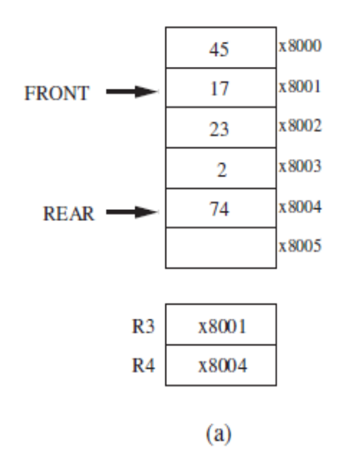
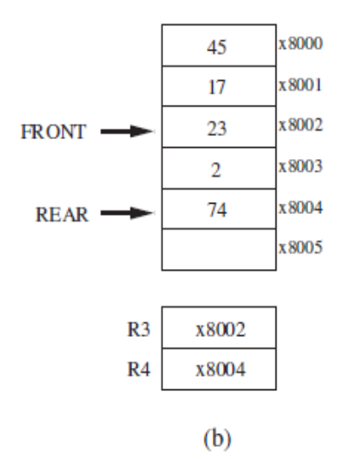
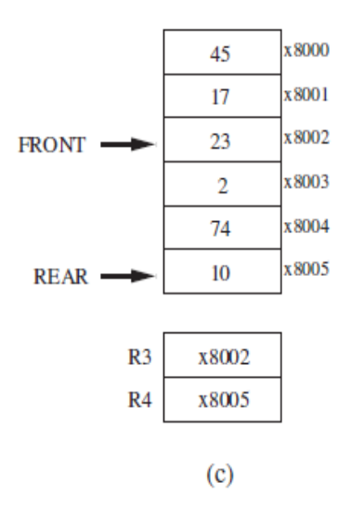
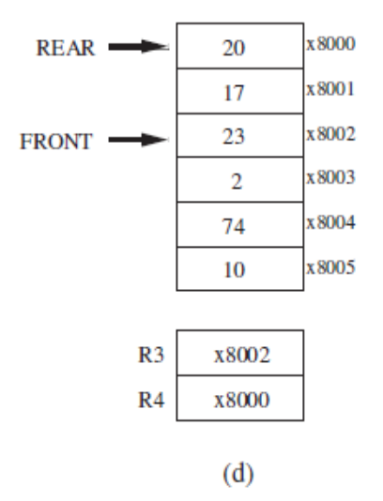
2.1 The Definition of Queue
Queue
  A data structure with the property of “First in First out”;
  Front pointer for removing elements from the front of the queue; Rear pointer for inserting into the rear of the queue.
  FRONT points to the location just in front of the first element in the queue; Rear points to the location of the last element in the queue.
Figure 8.25 A queue allocated to memory locations x8000 to x8005.

Slide 33
2.2 Basic Operations
Remove from Front
  FRONT points to the location just in front of the first element in the queue; R3 stores the FRONT pointer;
  First incrementing FRONT; then loading the value.
ADD R3,R3,#1
LDR R0,R3,#0
Insert at Rear
  First incrementing REAR; then storing the value. R4 stores the REAR pointer;
ADD R4,R4,#1
STR R0,R4,#0

Slide 34
2.3 Wrap-Around
Remove
;R3 stores FRONT pointer
LD R2, LAST
ADD R2,R3,R2
BRnp SKIP_1
LD R3,FIRST
BR SKIP_2
SKIP_1 ADD R3,R3,#1
SKIP_2 LDR R0,R3,#0
; R0 gets the front of the queue
RET
LAST .FILL x7FFB
; LAST contains the negative of 8005
FIRST .FILL x8000
Insert
;R4 stores REAR pointer
LD R2, LAST
ADD R2,R4,R2
BRnp SKIP_1 ； if(np) then
LD R4,FIRST ; SKIP_1:
BR SKIP_2 ; else
LD R4,first
SKIP_1 ADD R4,R4,#1 ; end if
SKIP_2 STR R0,R4,#0
; R0 gets the front of the queue
RET
LAST .FILL 7FFB
; LAST contains the negative of 8005
FIRST .FILL x8000

Slide 35
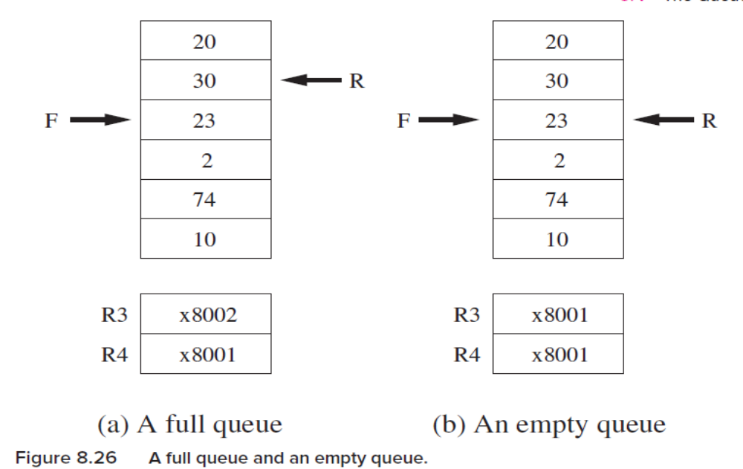
2.4 Full and Empty Queue
The queue are allowed to store only n-1 elements for a queue with n locations.
Full: FRONT=REAR+1 mod n Empty: FRONT=REAR

Slide 36
2.5 Tests for Underflow, Overflow
Test for underflow
AND R5,R5,#0
; Initialize R5 to 0
NOT R2,R3
ADD R2,R2,#1
; R2 contains negative of R3
ADD R2,R2,R4
BRz UNDERFLOW
……
; code to remove the front of the ;queue and return success.
RET
UNDERFLOW ADD R5,R5,#1
RET
R5=1: underflow
R5=0: normal
R3: FRONT
R4: REAR

Slide 37
2.6 The Complete Story
00 ;Input: R0 for item to be inserted, R3 is FRONT, R4 is REAR
01 ;Output: R0 for item to be removed
02 ;
03 INSERT ST R1,SaveR1 ; Save register we need
04 AND R5,R5,#0 ; Set R5 to success code
05 ; Initialization complete
06 LD R1,NEG_LAST
07 ADD R1,R1,R4 ; R1 = REAR MINUS x8005
08 BRnp SKIP1 ; SKIP WRAP AROUND
09 LD R4,FIRST ; WRAP AROUND, R4=x8000
0A BR SKIP2
0B SKIP1 ADD R4,R4,#1 ; NO WRAP AROUND, R4=R4+1
0C SKIP2 NOT R1,R4
0D ADD R1,R1,#1 ; R1= NEG REAR
0E ADD R1,R1,R3 ; R1= FRONT-REAR FRONT+1=REAR
0F BRz FULL
10 STR R0,R4,#0 ; DO THE INSERT
11 BR DONE
12 FULL LD R1,NEG_FIRST
13 ADD R1,R1,R4 ; R1 = REAR MINUS x8000
14 BRnp SKIP3
15 LD R4,LAST ; UNDO WRAP AROUND, REAR=x8005
16 BR SKIP4
17 SKIP3 ADD R4,R4,#-1 ; NO WRAP AROUND, R4=R4-1
18 SKIP4 ADD R5,R5,#1 ; R5=FAILURE
19 BR DONE
1A ;
1B REMOVE ST R1,SaveR1 ; Save register we need
1C AND R5,R5,#0 ; Set R5 to success code
1D ; Initialization complete
1E NOT R1,R4
1F ADD R1,R1,#1 ; R1= NEG REAR
20 ADD R1,R1,R3 ; R1= FRONT-REAR
21 BRz EMPTY
22 LD R1, NEG_LAST
23 ADD R1,R1,R3 ; R1= FRONT MINUS x8005
24 BRnp SKIP5
25 LD R3, FIRST ; R3=x8000
26 BR SKIP6
27 SKIP5 ADD R3,R3,#1 ; R3=R3+1
28 SKIP6 LDR R0,R3,#0 ; DO THE REMOVE
29 BR DONE
2A EMPTY ADD R5,R5.#1 ; R5=FAILURE
2B DONE LD R1,SaveR1 ; Restore register
2C RET
2D FIRST .FILL x8000
2E NEG_FIRST .FILL x8000
2F LAST .FILL x8005
30 NEG_LAST .FILL x7FFB
31 SaveR1 .BLKW 1

Slide 38
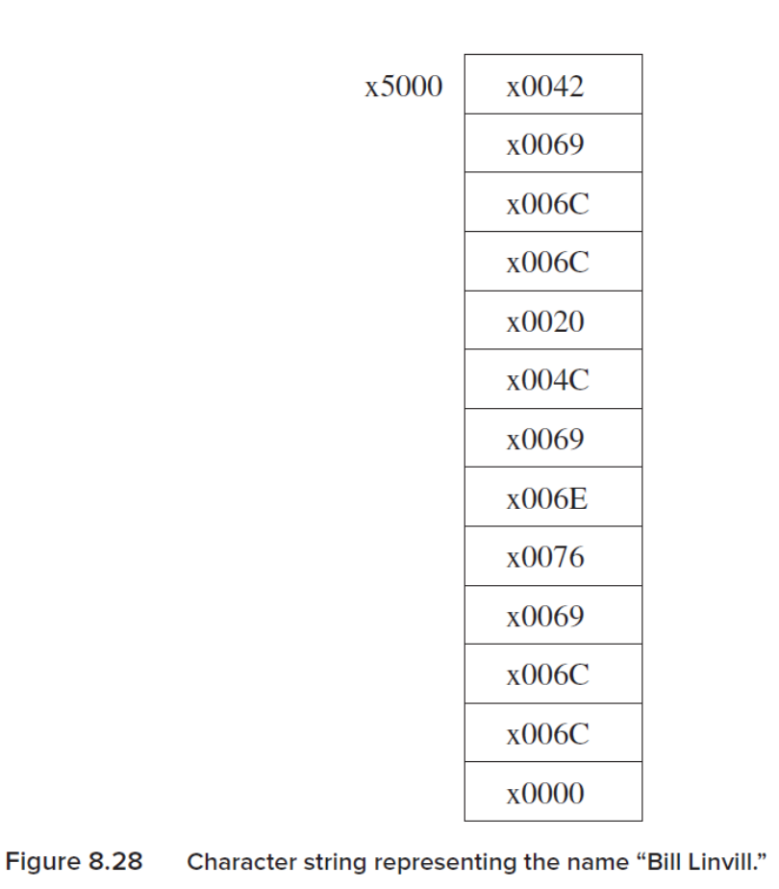
3. Character Strings
one-dimensional array of ASCII codes often followed by x0000 (null character).
Each location stores an ASCII codes of a character.

Slide 39
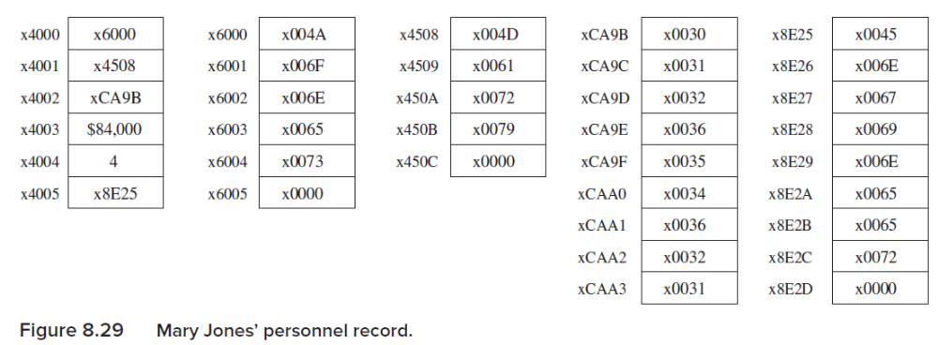
Example 1: Personnel Record
Mary
Jones
012654621
Engineer
6 words of sequential memory starting at x4000:
  1. The first word contains the starting address of a character string containing the person’s last name. The pointer in location x4000 is the address x6000. The six-word character string, starting at x6000, contains the ASCII code for “Jones,” terminated with the null character.
  2. The second word, at x4001, contains a pointer to the character string of the person’s first name, in this case “Mary,” starting at location x4508.
  3. The third word, at x4002, contains a pointer (xCA9B) to her nine-digit social security number, the unique identifier for all persons working in the United States.
  4. The fourth word, at x4003, contains her salary (in thousands of dollars).
  5. The fifth word contains how long she has worked for the company.
  6. The sixth word is a pointer (x8E25) to the character string identifying her job title, “Engineer.”

Slide 40
Subroutine to compare two character strings
STRCMP ST R0,SaveR0
ST R1,SaveR1
ST R2,SaveR2
ST R3,SaveR3
;R0 points to 1st string, R1 points to 2nd string
AND R5,R5,#0 ; R5 <-- Match;
NEXTCH LDR R2,R0,#0
; R2 contains character from 1st string
LDR R3,R1,#0
; R3 contains character from 2nd string
BRnp COMPARE
; String is not done, continue comparing
ADD R2,R2,#0
BRz DONE
; If both strings done, match found
COMPARE NOT R2,R2
ADD R2,R2,#1
; R2 contains negative of character
ADD R2,R2,R3 ; Compare the 2 characters
BRnp FAIL ; Not equal, no match
ADD R0,R0,#1
ADD R1,R1,#1
BRnzp NEXTCH
; Move on to next pair of characters
FAIL ADD R5,R5,#1 ; R5 <-- No match
;
DONE LD R0,SaveR0
LD R1,SaveR1
LD R2,SaveR2
LD R3,SaveR3
RET
SaveR0 .BLKW 1
SaveR1 .BLKW 1
SaveR2 .BLKW 1
SaveR3 .BLKW 1
Given social security number in example 1, how to look for the salary?

Slide 41
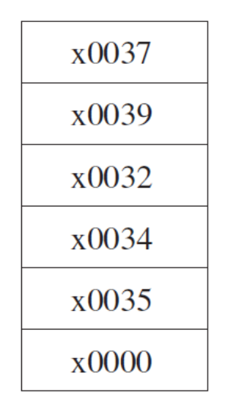
Example 2: Character String Containing an “Integer”
Check whether a string is the representation of a long integer.
.
; ; check whether R0 points to the representation of a long integer.
;Input: R0 contains the starting address of the character string
; Output: R5=0, success; R5=1, failure.
TEST_INTEGER ST R1,SaveR1
; Save registers needed by subroutine
ST R2,SaveR2
ST R3,SaveR3
ST R4,SaveR4
;
AND R5,R5,#0 ; Initialize success code to R5=0, success
LD R2,ASCII_0 ; R2=xFFD0, the negative of ASCII code x30
LD R3,ASCII_9 ; R3=xFFC7, the negative of ASCII code x39
;
NEXT_CHAR LDR R1,R0,#0 ; Load next character
BRz SUCCESS ; if current character is null
ADD R4,R1,R2
BRn BAD ; R1 is less than x30, not a decimal digit
ADD R4,R1,R3
BRp BAD ; R1 is greater than x39, not a decimal digit
ADD R0,R0,#1 ; Character good! Prepare for next character
BR NEXT_CHAR
BAD ADD R5,R5,#1 ; R5 contains failure code
SUCCESS LD R4,SaveR4 ; Restore registers
LD R3,SaveR3
LD R2,SaveR2
LD R1,SaveR1
RET
ASCII_0 .FILL xFFD0
ASCII_9 .FILL xFFC7
SaveR1 .BLKW 1
SaveR2 .BLKW 1
SaveR3 .BLKW 1
SaveR4 .BLKW 1
BAD ADD R5,R5,#1 ; R5 contains failure code
SUCCESS LD R4,SaveR4 ; Restore registers
LD R3,SaveR3
LD R2,SaveR2
LD R1,SaveR1
RET
ASCII_0 .FILL xFFD0
ASCII_9 .FILL xFFC7
SaveR1 .BLKW 1
SaveR2 .BLKW 1
SaveR3 .BLKW 1
SaveR4 .BLKW 1
Figure 8.31 A character string representing the integer
79,245, with one ASCII code per decimal digit.

